Slide 1
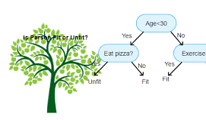
CART indicates Classification And Regression Trees.
Advantages of Decision Trees
Easy Interpretation
Making prediction is fast
Easy to identify important variables

Slide 2
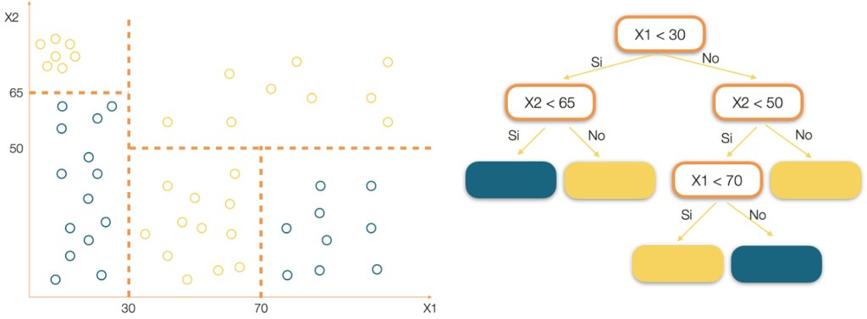
Decision Trees → Basic Ideas
Creating a CART model involves selecting input variables and split points on those variables until a suitable tree is constructed.
The selection of which input variable to use and the specific split or cut-point is chosen using a greedy algorithm to minimize a cost function. Tree construction ends using a predefined stopping criterion, such as a minimum number of training instances assigned to each leaf node of the tree.

Slide 3
Greedy Splitting
Creating a decision tree is actually a process of dividing up the input space. A greedy approach is used to divide the space.
This is a numerical procedure where all the values are lined up and different split points are tried and tested using a cost function. The split with the best cost (lowest cost because we minimize cost) is selected.
All input variables and all possible split points are evaluated and chosen in a greedy manner (e.g. the very best split point is chosen each time).
For regression predictive modeling problems, the cost function that is minimized to choose split points is the sum squared error across all training samples that fall within the rectangle:
sum(y – prediction)^2
Where y is the output for the training sample and prediction is the predicted output for the rectangle.
For classification the Gini index function is used which provides an indication of how “pure” the leaf nodes are (how mixed the training data assigned to each node is).
G = sum(pk * (1 – pk))
Where G is the Gini index over all classes, pk are the proportion of training instances with class k in the rectangle of interest. A node that has all classes of the same type (perfect class purity) will have G=0, where as a G that has a 50-50 split of classes for a binary classification problem (worst purity) will have a G=0.5.

Slide 4
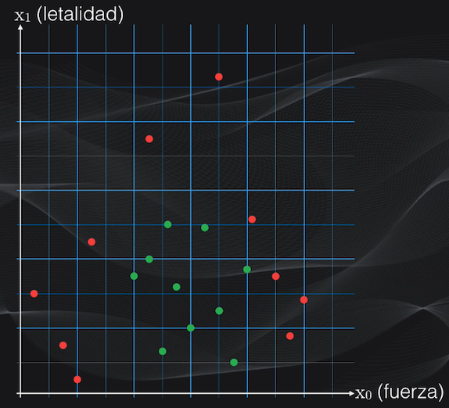
Classification of 20 individuals)

Slide 6
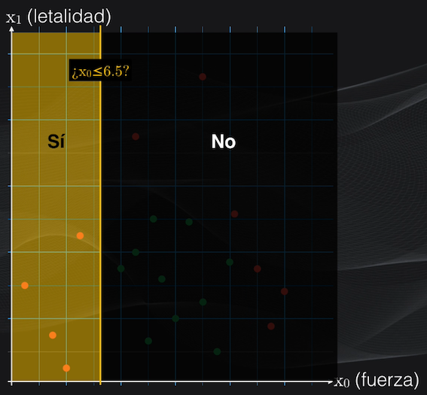
In the first iteration, a condition is defined and a first partition is generated.

Slide 7
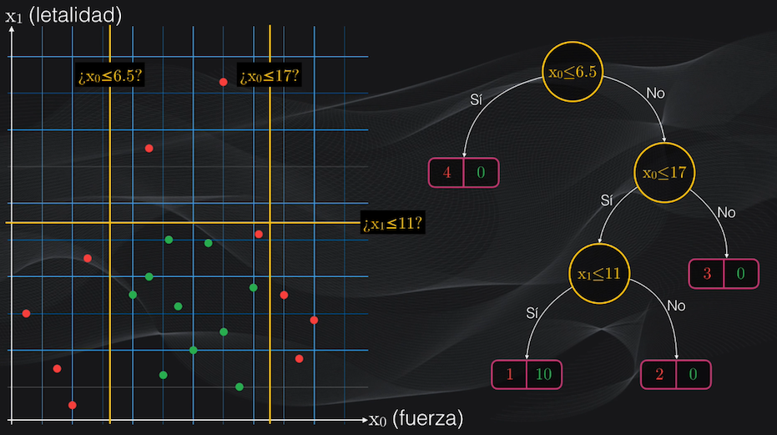
In the remaining iterations the initial procedure is repeated: a condition is defined and new partitions are generated.

Slide 8
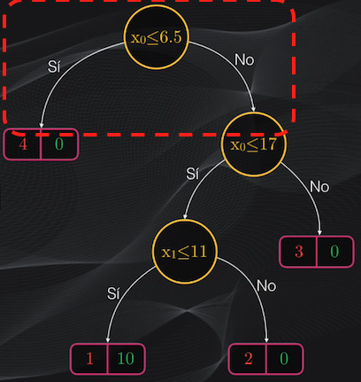
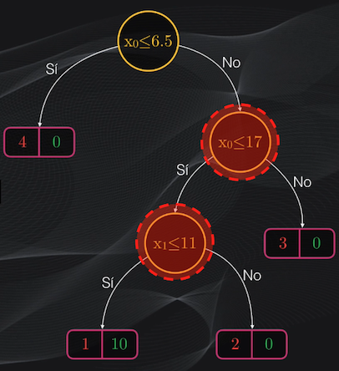
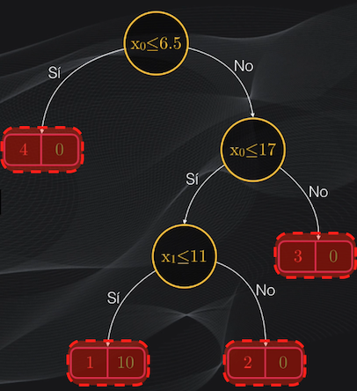
Decision Trees → Concepts

Slide 9
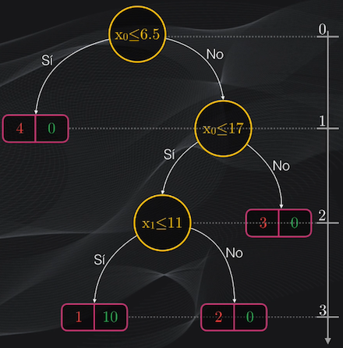
Decision Trees → Concepts

Slide 10
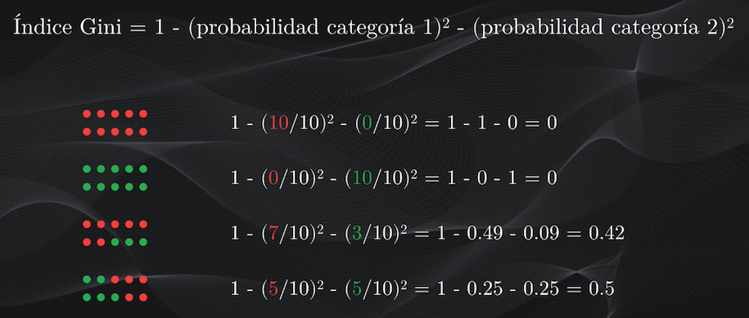
HOW TO CONSTRUCT THE TREE (CART) ?
The Gini index: a measure of homogeneity.
The Gini index is used, which measures the degree of "impurity" of a node: Gini indices equal to zero indicate pure nodes (that is, with data belonging to a single category), while indices greater than zero and with values ​​up to one indicate nodes with impurities (that is, with data from more than one category).

Slide 11
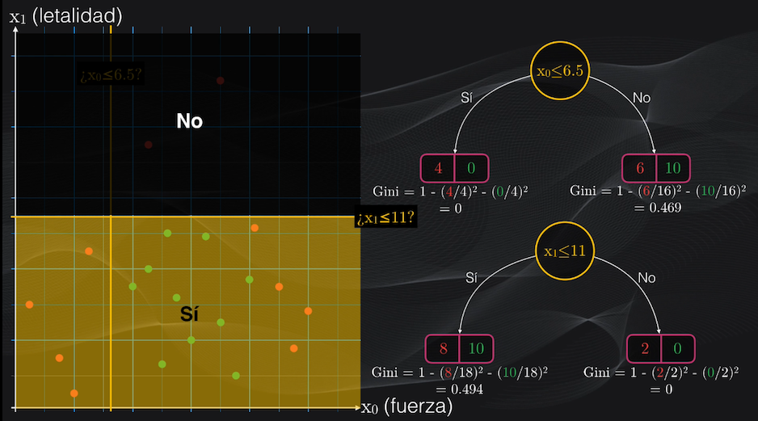

Slide 12
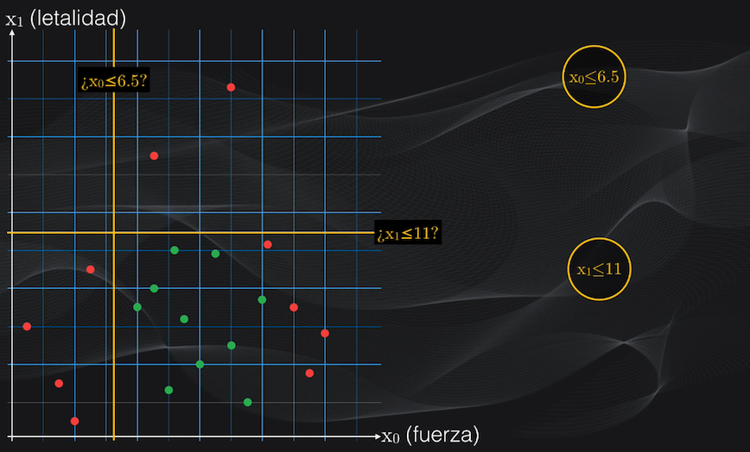
The cost function: what is the best partition? To find out which of these two partitions is the best, the CART algorithm defines a cost function that assigns a score to the parent node, using the weighted average of the individual Gini indices of its child nodes.

Slide 13
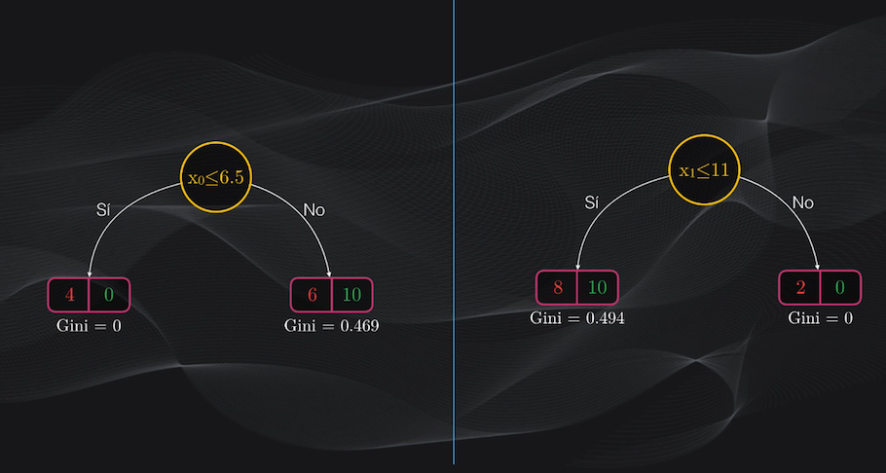
This is calculated by taking the Gini index corresponding to each node and multiplying it by the result of dividing the number of data belonging to the new cluster by the total number of data before partitioning.
Example: Cost for Xo<=6.5
0*((4+0)/20) + 0.469*((6+10)/20) = 0 + 0.375 = 0.375
Cost for X1<=11 = 0.446

Slide 14
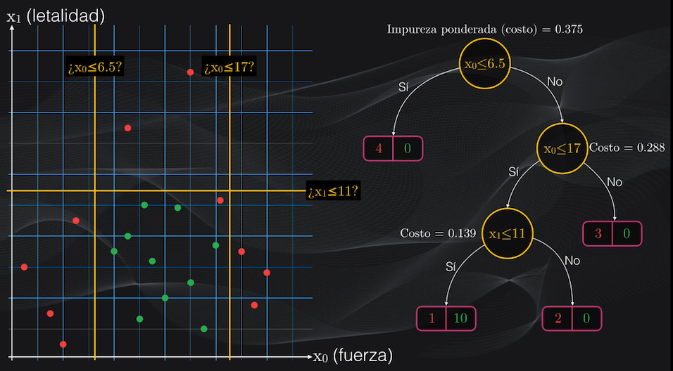

Slide 15
In short: CART algorithm for classification:
1→ To create the root of the tree, that is to say the first partition, all the characteristics are taken and, for each one of them, all the possible thresholds are defined. Each threshold will simply be the intermediate point between two consecutive values ​​of each characteristic. For example, in the particular case of our data set we have two characteristics (X1, X2). As in total we have 20 data, for each characteristic there will be 19 thresholds, so in total we will have 38 thresholds to evaluate.
2→For each of these thresholds the partition (left node and right node) is calculated and for each child node the Gini index is calculated. With these child nodes, the cost function of the parent node is calculated, which is the weighted average of the Gini indices of its children. The threshold (or resulting parent node) that has the cost function with the lowest possible value is taken, indicating that the partition obtained is the most homogeneous of all those analyzed. Once this partition has been made, the same procedure is repeated iteratively for the resulting nodes, except for those that are leaf nodes.

Slide 16
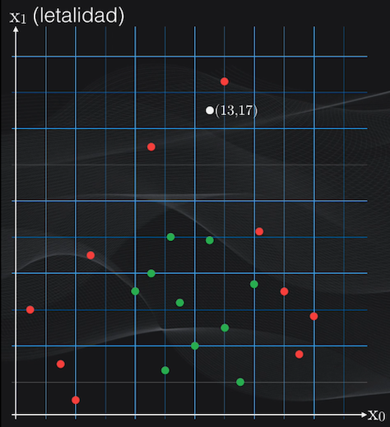

Slide 17
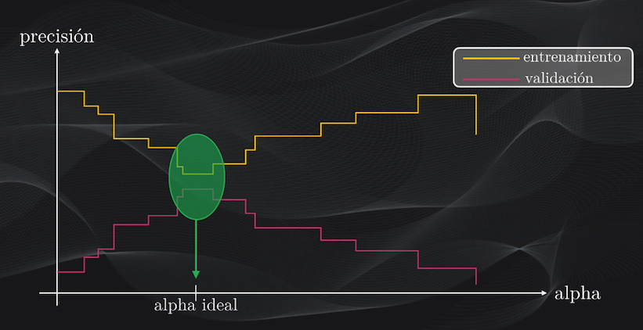
cp is the complexity parameter

Slide 18
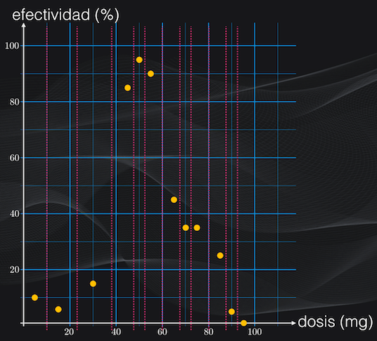
CART → For Regression Task

Slide 19
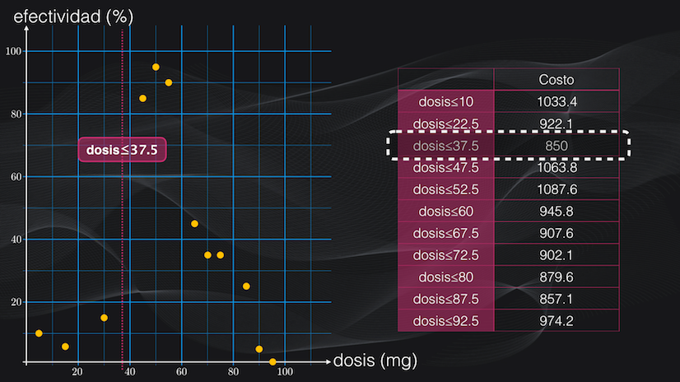
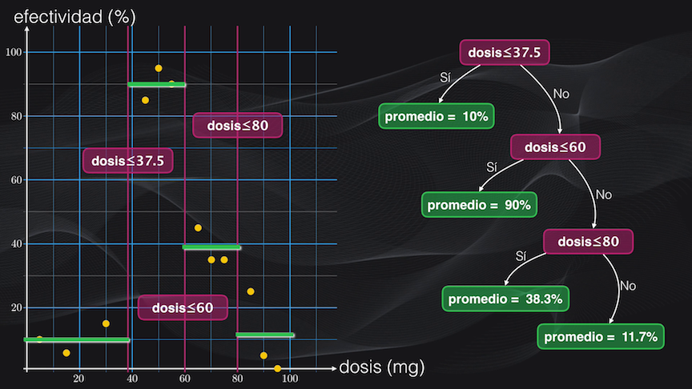
CART → For Regression Task

Slide 20
Choosing the trees split points
Technically, for regression modeling, the split cutoff is defined so that the residual sum of squared error (RSS) is minimized across the training samples that fall within the subpartition.
Recall that, the RSS is the sum of the squared difference between the observed outcome values and the predicted ones, RSS = sum((Observeds - Predicteds)^2).
In classification settings, the split point is defined so that the population in subpartitions are pure as much as possible. Two measures of purity are generally used, including the Gini index and the entropy (or information gain).
For a given subpartition, Gini = sum(p(1-p)) and entropy = -1*sum(p*log(p)), where p is the proportion of misclassified observations within the subpartition.
The sum is computed across the different categories or classes in the outcome variable. The Gini index and the entropy varie from 0 (greatest purity) to 1 (maximum degree of impurity)

Slide 21
rpart(formula, data, weights, subset, na.action = na.rpart, method, model = FALSE, x = FALSE, y = TRUE, parms, control, cost, ...)
rpart(formula, data, method, parms, control, ...)
formula: Y ~ f(predictors)
data: your data (training dataset)
method: "anova" (regression), "class" (classification), "poisson" (Poisson Regression) or "exp" (suvirval analysis)
cp is the complexity parameter
xval number of folds for cross-validation

Slide 22

Random Forests
randomForest(formula, data, ntree, mtry, nodesize, ...)
ntree: by default 500.
mtry: number of predictors randomly selected in each division; by default → max(floor(p/3), 1) for regression and floor(sqrt(p)) for classification, being p = ncol(x) = ncol(data) - 1 (number of predictors).
nodesize: By default 1 in classification and 5 for regression (it is recommended to increase this value for large datasets)
importance = TRUE:
na.action = na.fail; estableciendo na.action = na.roughfix or rfImpute()

Slide 23
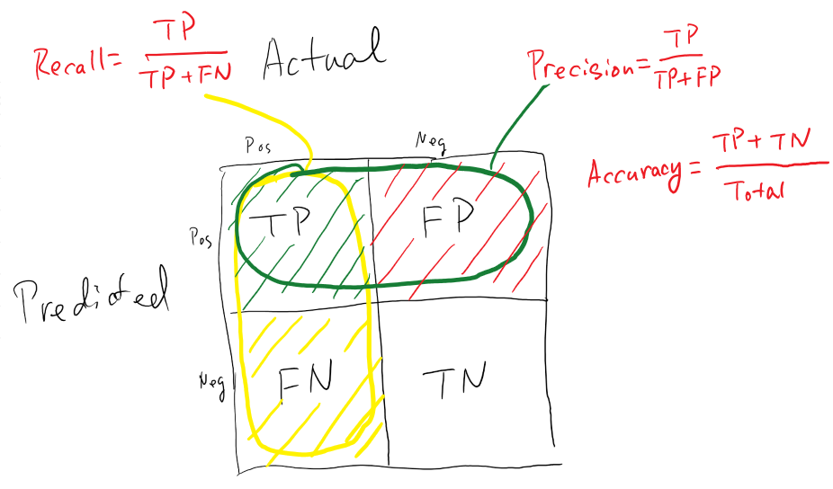
Confussion Matrix

Slide 24

KPIs for Regression Problems
MAE, RMSE, MAPE, ETC

